Slide 1
MILESTONE 1 Salary Survey EXCEL & SQL KISHORE VASUDEVAN 11/04/2025 DATA ANALYTICS & DATA SCIENCE FEB 25’

Slide 2
PROJECT OVERVIEW
The dataset represents a salary survey of individuals across various industries and job roles. It includes details such as age range, country, state, city, gender, and education level. The dataset contains approximately 28,103 records, providing a comprehensive view of global compensation trends.
OBJECTIVE :
Analyze global salary trends across demographics, industries, roles, and education levels.
TOOLS USED :
Excel
SQL

Slide 3
DATA CLEANING & PREPARATION
Removed duplicate entries using the “Remove Duplicates” feature (151 Records).
Performed spell checks across all columns and corrected errors.
Standardized city names using the Geography data type in Excel.
Grouped gender values into: Male, Female, Non-Binary, Others.
Converted all salary values to USD based on exchange rates by country.
Identified outliers using the quartile (IQR) method. Retained them, as even $1 can be a valid salary.
After cleaning, we have a total of 26,719 records.
Executed data analysis using SQL queries for insights.

Slide 4
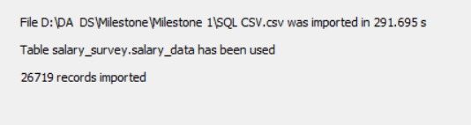
SQL IMPORT
After cleaning, the entire dataset needs to be imported into SQL.
Create a database named Salary_Survey.
Create a table named Salary_data.
After creating the table, right-click on it and select 'Table Data Import Wizard’ to import data.
In the wizard, fill in the respective columns and click 'Next' to import the data.
The screenshot below shows that 26,719 records have been successfully imported.

Slide 5
HIGH PAYING COUNTRY

Slide 6
HIGH PAYING INDUSTRY

Slide 7
HIGH PAYING JOB ROLE

Slide 8
EDUCATION

Slide 9
GENDER
Female : 20404
Male : 5319
Non-Binary : 722
Others : 275

Slide 10
AGE RANGE

Slide 11
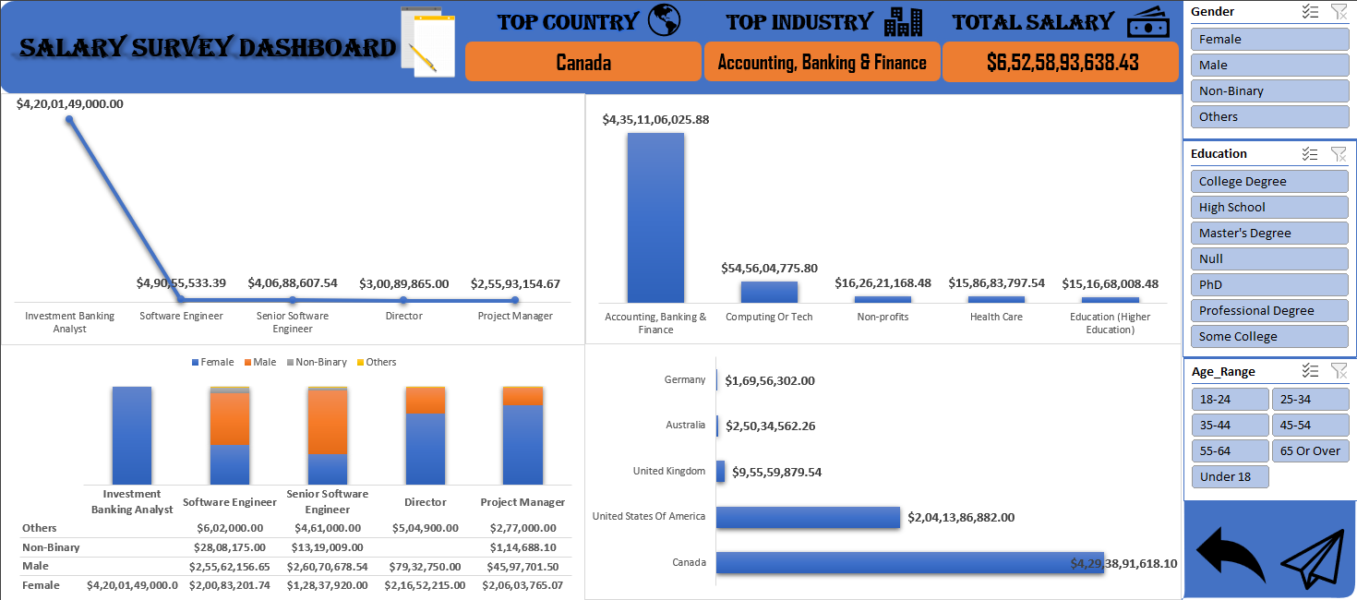
DASHBOARD

Slide 12
INSIGHTS
Software Engineers and Senior Software Engineers dominate total compensation across all job titles.
The Computing & Tech industry is both the highest-paying and the largest in terms of workforce.
Non-Binary individuals, while fewer in number, receive some of the highest base salaries, especially in younger age groups.
College degree offer the highest average.
The USA leads globally in maximum salaries across multiple roles.
Experience levels of 2–4 years and 11–20 years appear to be the most financially rewarding ranges.

Slide 13
FINDINGS
The Computing & Tech industry employed the largest number of professionals (4,533), especially those with 11–20 years of experience.
Inside Sales Manager in the USA had the highest single salary entry at $5M.
The highest maximum salary by education was seen under a Master’s degree ($5M), while the highest average was for a College degree ($132K).
Males received 53.49% of the total additional compensation distribution.
New Haven’s(Connecticut, US) Healthcare sector paid an average of $985K, the highest average by city-industry combo.

Slide 14
CONCLUSION
This analysis provided a comprehensive view of global salary trends across various demographics, roles, industries, and education levels.
Key findings reveal that the Computing & Tech industry consistently offers high compensation and employment opportunities, while education level and years of experience significantly influence earning potential.
Overall, the insights derived from this dataset can guide career planning, compensation and industry-level talent strategies.

Slide 15
THANK YOU !!!

